Slide 1


Car Sales Analytics Dashboard
Comprehensive SQL analysis revealing customer behavior, dealer performance, and market trends in automotive sales.

Slide 2
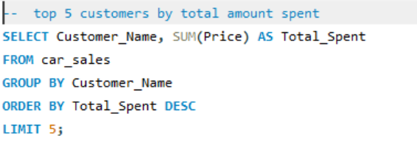
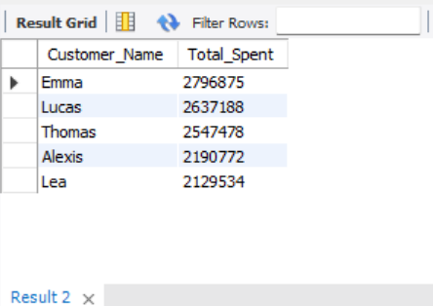
Top 5 Customers by Spending
Identifying our highest-value customers through total purchase analysis. This query ranks customers by their cumulative spending, helping us understand who drives the most revenue.
5
Top Customers
Ranked by total spending
100%
Revenue Focus
Prioritize high-value relationships

Slide 3
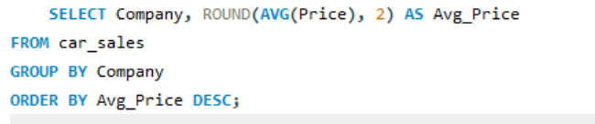
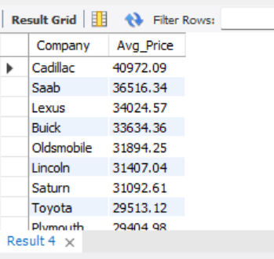
Average Car Price by Company
Understanding pricing strategies across manufacturers reveals market positioning and brand value perception.
Premium Brands
Mid-Market Players
Value Segment
Highest average prices indicate luxury positioning
Balanced pricing for volume sales
Competitive pricing drives accessibility

Slide 4
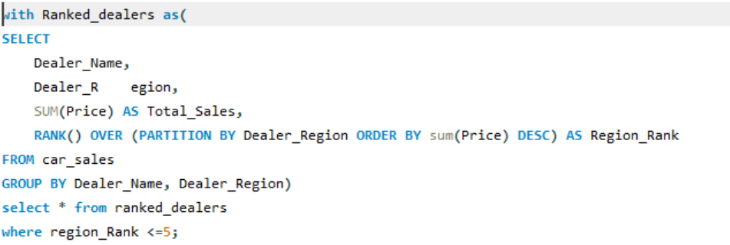
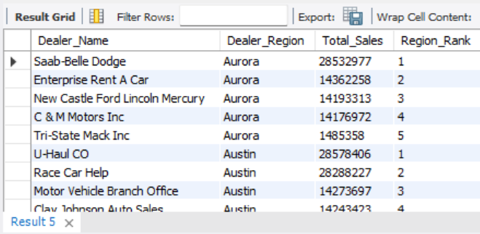
Regional Dealer Performance
Ranking top dealers within each region using window functions to identify sales leaders and best practices.

Slide 5
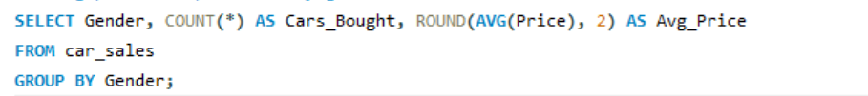
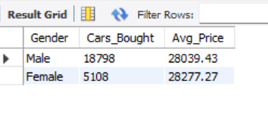
Customer Demographics: Gender Analysis
Purchase Patterns by Gender
Analyzing buying behavior and average spending across gender segments reveals important market insights.

Slide 6
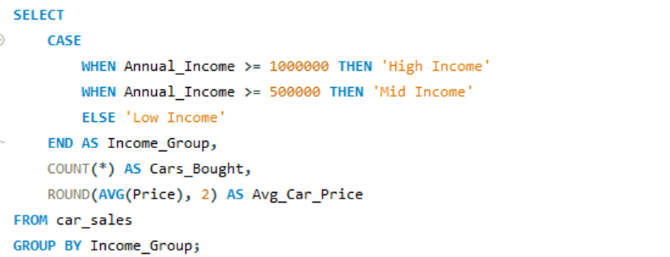
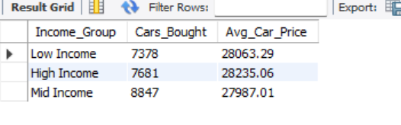
Income-Based Segmentation
High Income
Mid Income
Low Income
≥ ₹1,000,000 annual income
₹500,000 - ₹999,999 annual income
< ₹500,000 annual income
Premium vehicle preferences
Balanced value and features
Cost-effective options

Slide 7
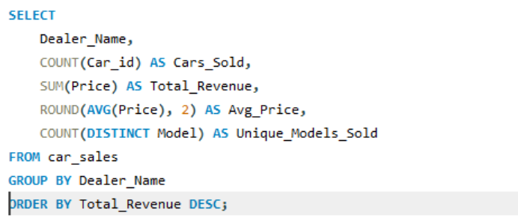
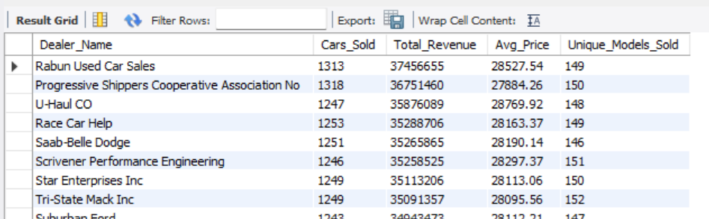



Dealer Performance Metrics
Comprehensive dealer analysis tracking sales volume,
revenue, pricing, and model diversity.
Volume Tracking
Revenue Analysis
Model Diversity
Total units sold per dealer
Total sales value generated
Unique models in inventory

Slide 8
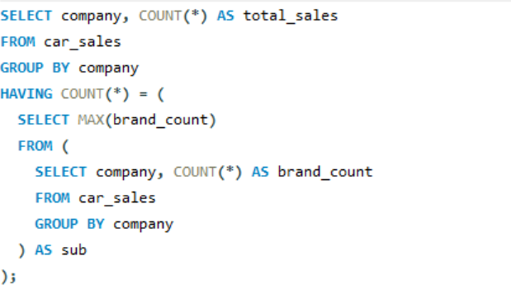
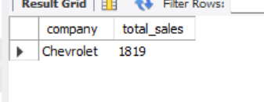
Top-Selling Company
Market Leader Identification
Finding the company with the highest total car sales using subquery aggregation.

Slide 9
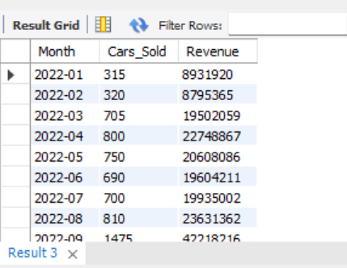
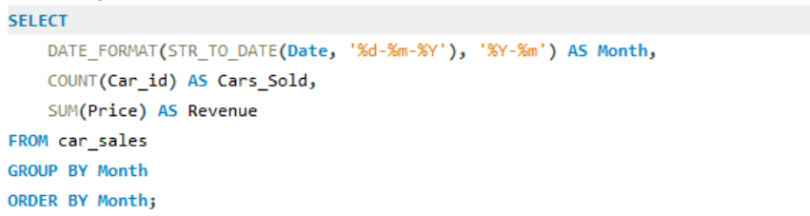
Monthly Sales Trends
Tracking sales volume and revenue patterns over time to
identify seasonal trends and growth opportunities.

Slide 10
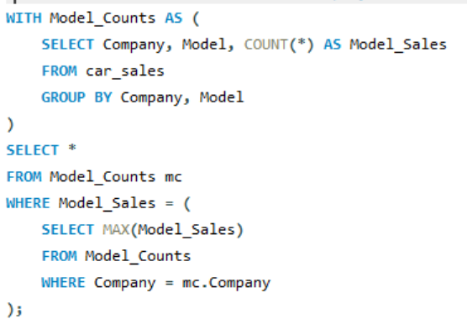
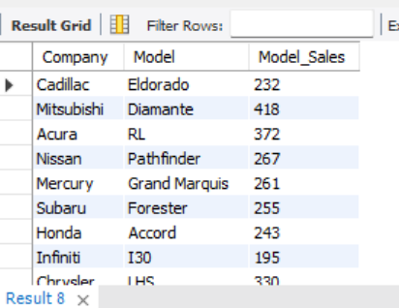
Most Sold Car Model per Company
Pinpoint the most popular car model for each manufacturer.
This helps dealerships and marketing teams understand which models dominate sales and deserve priority in inventory,
advertising, and production planning.

Slide 11
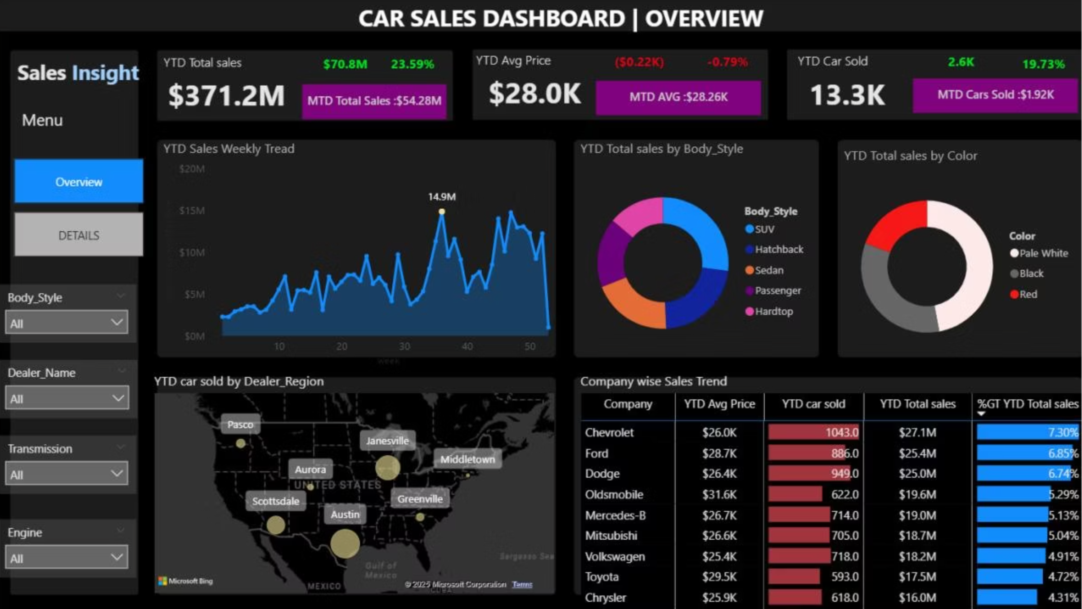

Slide 12
